Slide 1
Summary of PMR 74179,614,760:
Issue:
Yachiyo Industry would like to use "About me" and "Experience" of My Profile to publish their employees' skills and experience.
However, some Japanese keywords doesn't hit correctly in Profile search. (Nevertheless, the same Japanese keyword hits correctly in Blog search.)
For example, "機械" that is Japanese search keyword doesn't hit even if Experience of My Profile has "狭山大学工学部機械工学科卒業" that is Japanese sentence.
The customer has also unique terms and they would like to know how to register dictionaries to improve the capability of Profile search.
Response from technical support of Japan:
Connections Cloud doesn't have the capability to register customer's own dictionaries.
Connections Cloud tries to distinguish the language of the search keywords and contents and when Connections Cloud didn't distinguish the language of them, then the default language of dictionary is used.
(The default dictionary of the customer's organization is Japanese.)
For example, the customer is using Japanese language normally, If Connections Cloud distinguishes the keywords and contents as Chinese, not Japanese, then Chinese dictionary is used for contents indexing and for keyword search.
Therefore, since the search index is created by the selected dictionary, some keyword doesn't hit in Profile search. It's necessary to add n-gram search for Profile search to resolve search result consistency in Japanese environment to keep search quality.

Slide 2
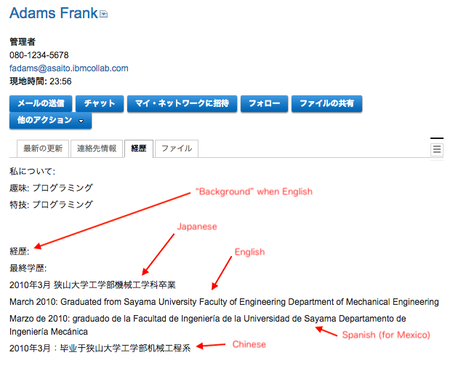
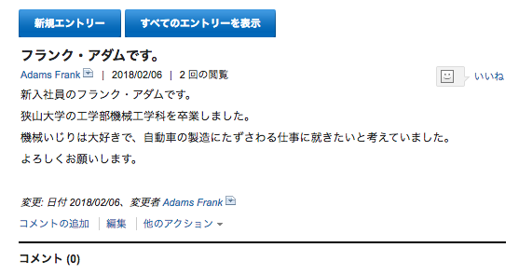
Here is an example.
1. There is a following data in Profile and Blog.
Profile data (Usually uses “biography” data)
Blog data
“biography”

Slide 3
2. Test 9 search keywords of Japanese.
We tested 9 search keywords with all contents (cross search) on Connections Cloud.
(1) 狭山
(2) 大学
(3) 工学部
(4) 機械
(5) 工学
(6) 卒業
(7) 狭山大学
(8) 機械工学
(9) 機械工学科

Slide 4
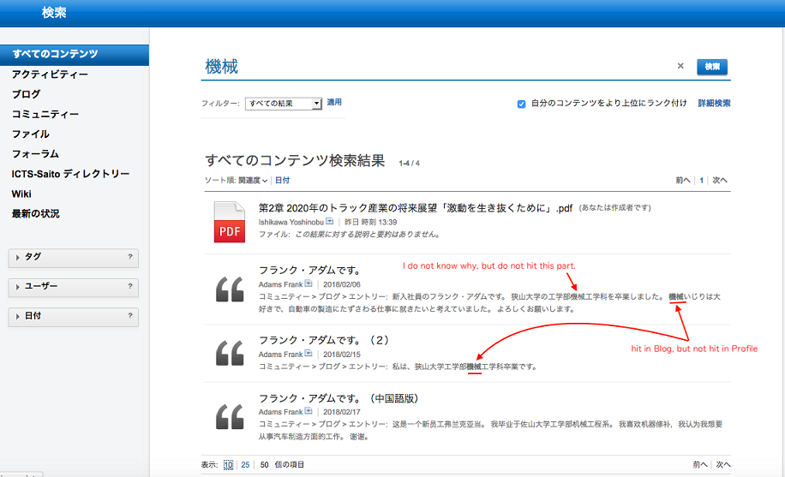
3. Result of the Profile Search:
Two keywords that are (4) and (5) do not hit in Profile but hit in Blog.
Other key wards hit both in Profile and Blog.
3-1. The search result of keyword (4) “機械”
The result is only shown in blog

Slide 5
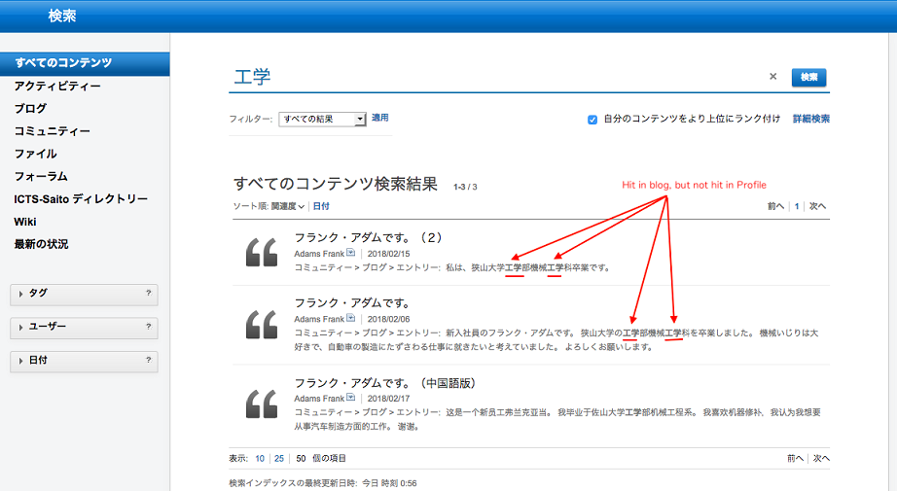
3-2. The search result of keyword (5) “工学”
The result is only shown in blog

